Slide 1
Webinar on carbon finance facilitation in e-mobility in South Africa
Making e-Mobility Profitable with Carbon Credits
www.zeroca.world

Slide 2
Agenda:
Time | Program | Presenter
15:00 – 15:10 | Welcome Remarks | Enya Grutter Communications Manager
15:10 - 15:35 | Program Presentation | Guillaume Remy Co-Founder of Zeroca
15:35 – 15:50 | Q&A
15:50 – 16:00 | Closing Remarks | Enya Grutter Communications Manager
banks

Slide 3
Introducing Our Joint Experience in E-Mobility
Introducing Guillaume Remy
Zeroca is a joint venture of two experienced advisory and investment boutiques
Our joint experience covers:
Electric bus projects in 30+ countries worldwide
including deployment of 40,000 electric buses in 20 cities of China
Electric truck, van, passenger car, motorcycle, 3-
wheeler and vessel projects in Asia, Africa, Europe and the Americas
Charging infrastructure roadmaps and projects in 10+ countries
Port electrification and terminal optimisation practice
Trusted advisor to development partners, operators and banks

Slide 4
Carbon Credits E-Mobility
Making e-Mobility Profitable With Carbon Credits
Can make investments in e-mobility more
profitable
In most cases it will not pay for the total additional cost
It is results-based and not upfront finance; third-party financing is possible but expensive
You receive payments for 5-10 years

Slide 5
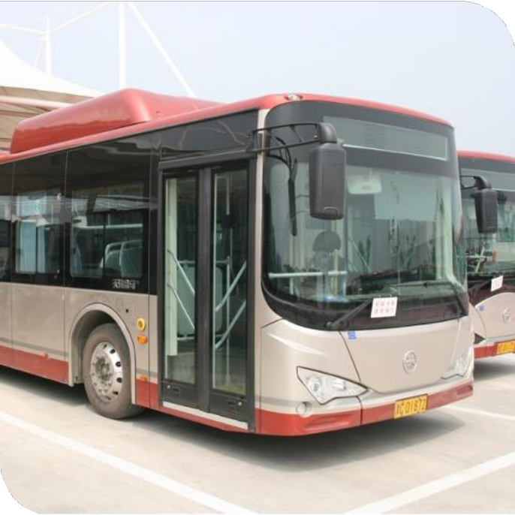
Electric Buses
Making e-Mobility Profitable With Carbon Credits
Urban or inter-urban buses of all sizes
Needs to be fully electric (no hybrids)
Intercity Bus

Slide 6
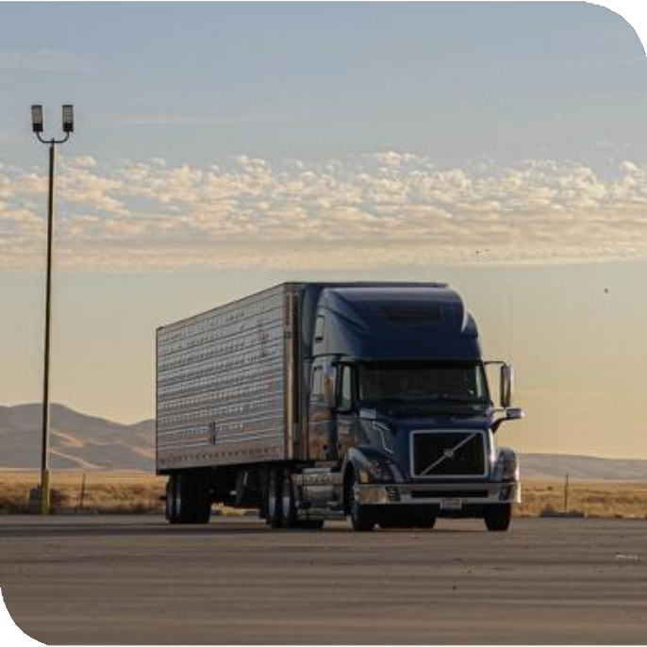
Electric Trucks
Making e-Mobility Profitable With Carbon Credits
Delivery trucks or long-haul trucks of all sizes
Only battery-electric trucks

Slide 7
Electric Motorcycles and 3-Wheelers
Making e-Mobility Profitable With Carbon Credits
Motorcycles or 3-wheelers for ride- hailing or rent
Motorcycles or 3-wheelers for delivery
Private units can also be included

Slide 8
Making e-Mobility Profitable With Carbon Credits
Passenger Cars
Including Taxis ​
Ride - hailing Vehicles
LCVs (light commercial vehicles, including vans)

Slide 9
Making e-Mobility Profitable With Carbon Credits
Electric Pick - Ups

Slide 10
Making e-Mobility Profitable With Carbon Credits
Vans
Vans
Light load Vehicles

Slide 11
Making e-Mobility Profitable With Carbon Credits
Electric minibus taxis

Slide 12
Making e-Mobility Profitable With Carbon Credits
Chargers

Slide 13
Who can participate
Making e-Mobility Profitable With Carbon Credits
Operators of electric vehicle fleet such as buses, trucks, delivery vehicles, mining equipment, port and airport equipment, etc.
Charge point owners or operators
Electric vehicle manufacturers, importers and dealers
Leasing companies or owners of vehicle
assets (e.g. buses) lent to operators

Slide 14
What is required
Making e-Mobility Profitable With Carbon Credits
To Participate, clear ownership of the emission reduction is required
For charging points electricity consumption data is needed
For vehicles annual mileage and vehicle ID is needed

Slide 15
Making e-Mobility Profitable With Carbon Credits
Receiver country
How an aggregation program is structured
Registration of program
Monitoring data
Contract
Participating company A
…..............
Host country
Participating company B
Aggregator and program owner
........
Participating company C
Participating company D
Payment for offsets
Contract
Participating
company E
Buyer
offsets

Slide 16
Making e-Mobility Profitable With Carbon Credits
Timeline
Initial assessment
Several weeks / months
Contracting
Project/program development, validation, registration *
12-24 months
annual cycle
Monitoring
Monitoring
report
Issuance of offsets by governments
Payment to
participant
Monitoring for 12 months
2 months
6 months (includes external review)
30 days
* Indicative durations; timeline realization depends on program, project, participant, country, standard and validation, verification and endorsement processes by various external parties

Slide 17
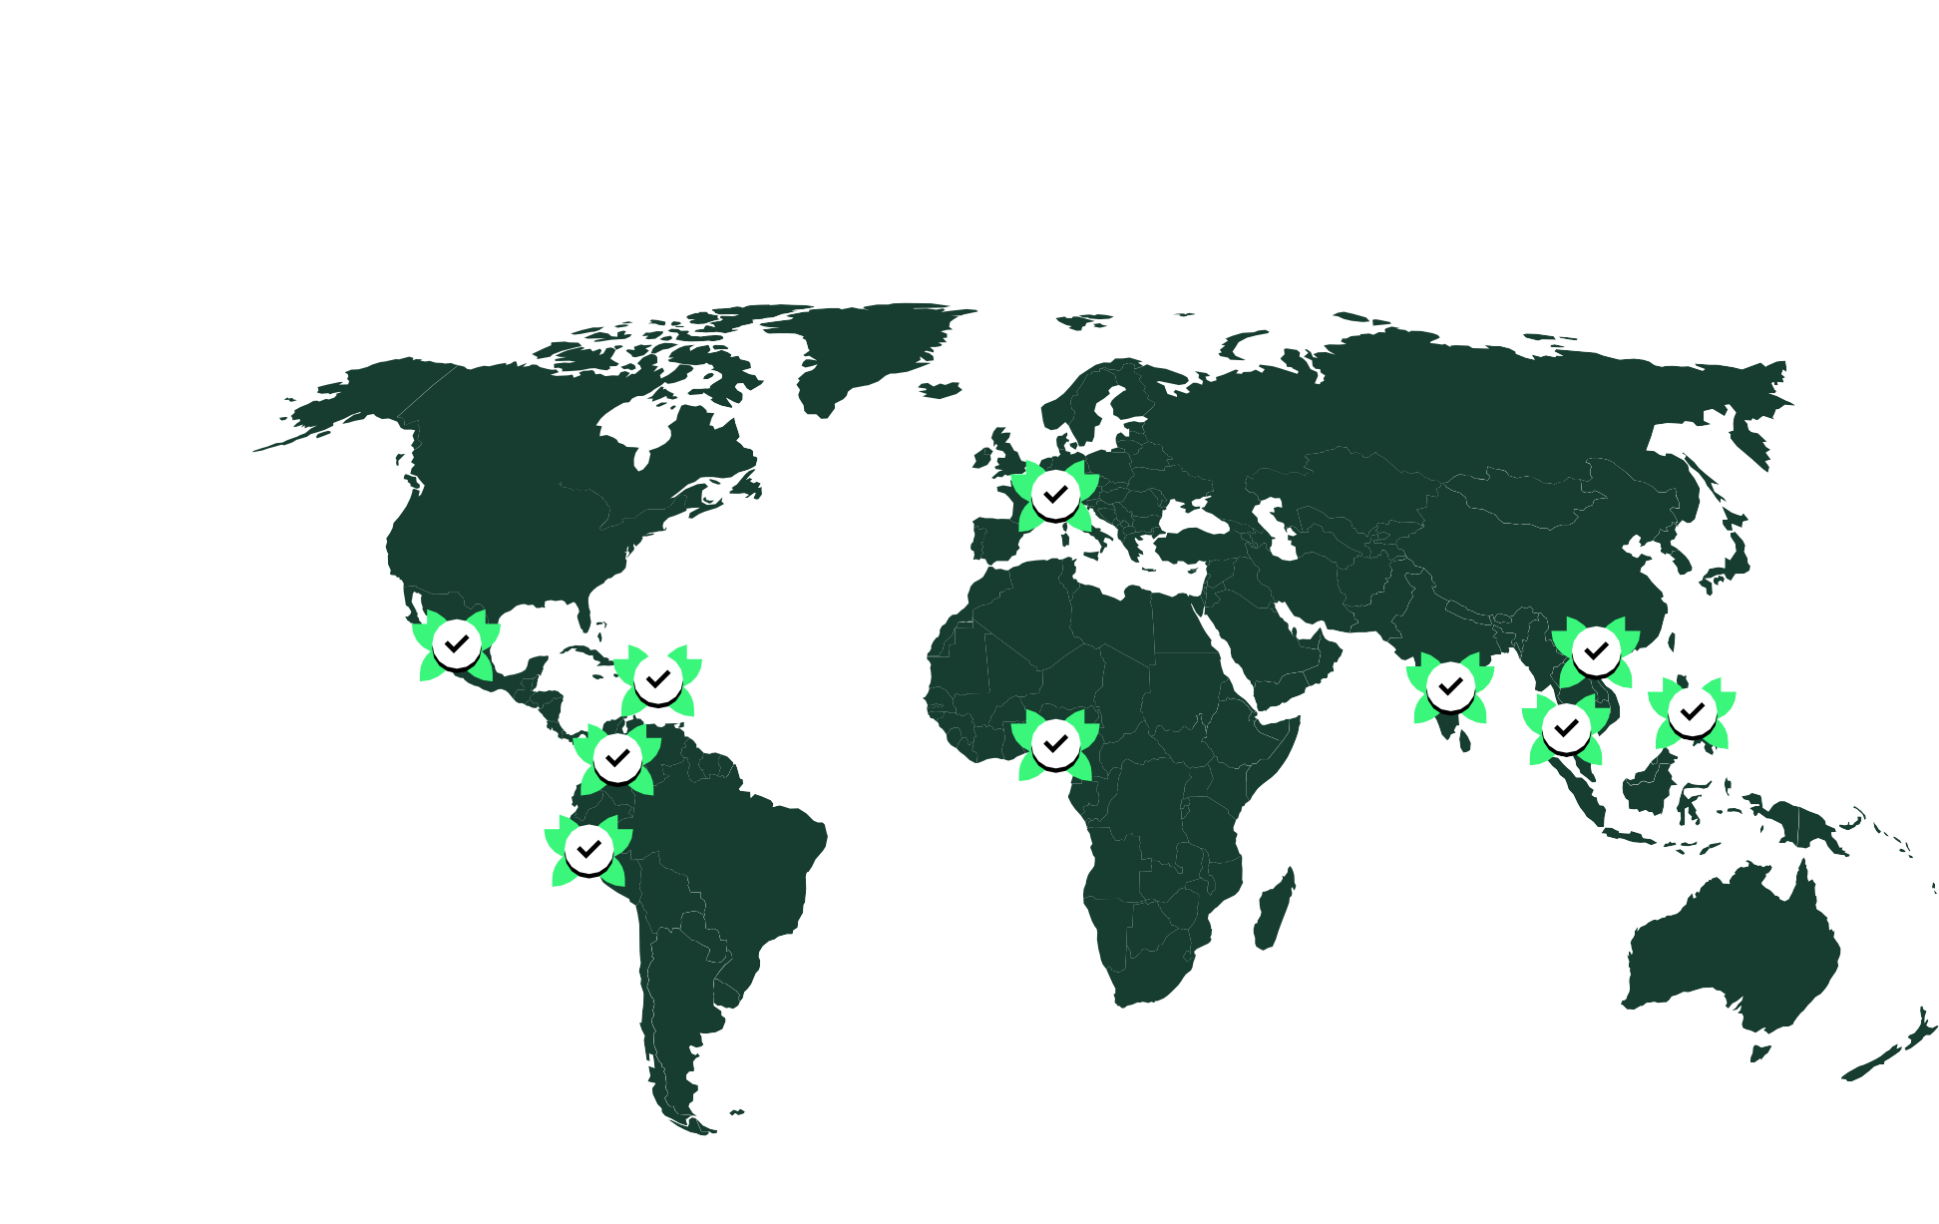
Our E-Mobility Programs with Carbon Credits
Making e-Mobility Profitable With Carbon Credits
Chile
Colombia
Dominica
India
Mexico
Nepal
Nigeria
Peru
Philippines
South Africa
Switzerland
Thailand
Uruguay
Vietnam
www.zeroca.world/experience

Slide 18
Making e-Mobility Profitable With Carbon Credits
Questions ?

Slide 19
Guillaume Remy
Making e-Mobility Profitable With Carbon Credits
guillaume.remy@zeroca.world
www.zeroca.world

